Slide 1
Body Membranes
Anatomy 3.1

Slide 2
Epithelial Membranes:
Membranes that LINE the body

Slide 3
Cutaneous Membrane:
A.K.A: Skin!
Dry Membrane
Exposed to air

Slide 4
Mucous Membrane:
Line body cavities that open to the exterior
Wet/moist membrane
Bathed in secretions

Slide 5
Serous Membrane:
Lines body cavities that are closed within the body.
Occurs in pairs:
Visceral: Touches organ
Parietal Does NOT touch organ

Slide 6
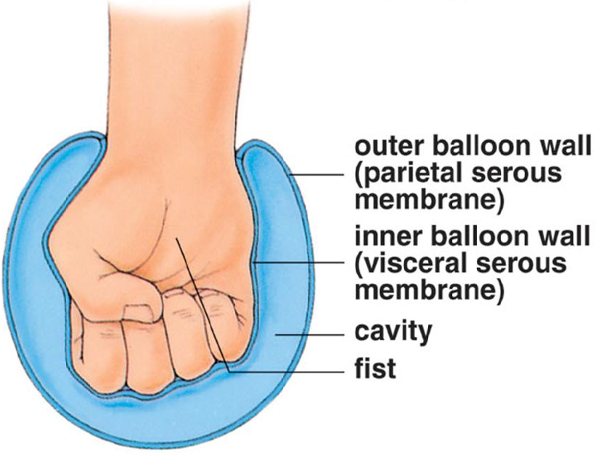
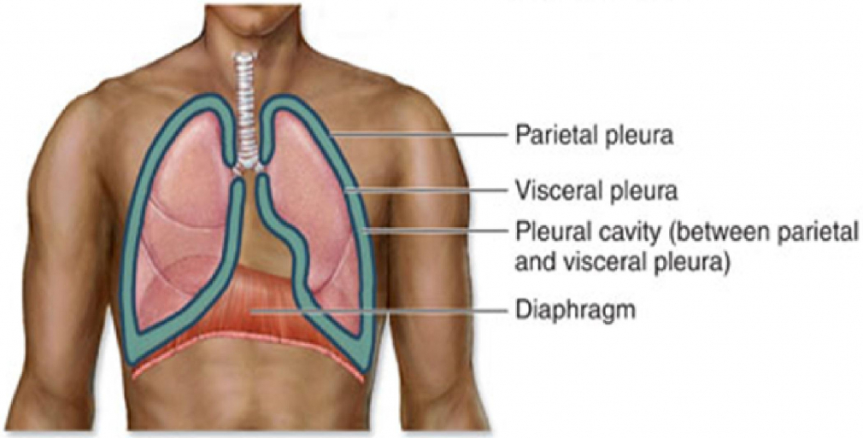
Membranes are separated by Serous Fluid

Slide 7
Connective Membrane:
Synovial Membrane
Found surrounding your joints.
Provides smooth surface & secretes lubricating fluid
Only connective tissue (no epithelial)

