Slide 1
Bone Shapes
Anatomy 4.3

Slide 2
Long Bones
Longer than wide
Shaft with head
Found in limbs
Made of compact bone

Slide 3
Short Bones
Cube-shaped
Found in wrists & ankles
Made of spongy bone

Slide 4
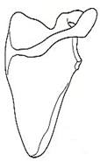
Flat Bones
Thin/flattened/curved
Spongy bone covered in compact bone
Ex. Skull, ribs, sternum

Slide 5
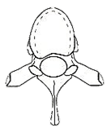
Irregular Bones
“Junk Drawer”
Don’t fit other categories
Ex. Hips, Vertebrae

Slide 6
Epiphysis
Compact & Spongy Bone
Ends of long bone
Red bone marrow

Slide 7
Diaphysis
Compact Bone
Shaft (length) of long bone
Yellow bone marrow
(adipose storage)

Slide 8
Periosteum
Fibrous connective tissue that covers the diaphysis

Slide 9
Articular Cartilage
Slippery covering on epiphyses
Provides smooth movement

Slide 10
Epiphyseal Plate
Plate of cartilage in epiphysis of young bone
Growth still occurring

Slide 11
Epiphyseal Line
“Scar” left when cartilage plate ossifies (hardens) into bone
Growth complete

Slide 12
Structure of a Long Bone
Epiphysis
Diaphysis
Epiphysis
Spongy Bone
Compact Bone
Medullary
Cavity
Periosteum

