Slide 1
Anatomy of Compact Bone
Anatomy 4.4

Slide 2
Why does compact bone look the way it does?
Cells are frozen in place, so the arrangement allows blood to pass through the cells

Slide 3
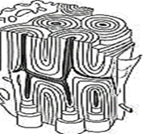
Haversian Canal | Vertical channel through which blood vessels pass
Volkmann’s Canal (Perforating) | Horizontal channel that connect two Haversian canals

Slide 4
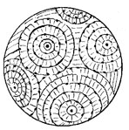
Osteon | Cylindrical, functional unit of compact bone
Lamella | Concentric rings formed around the canals

Slide 5
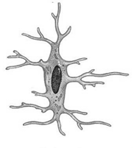
Osteocyte | Mature bone cell that lives in lake lacuna
Lacunae | “Lake” that houses osteocytes
Canaliculi | “Canals” that extend from lacunae

