Slide 1
Hair & Nails
Anatomy 3.4

Slide 2
Function:
Protects skin, provides warmth, & detects stimuli

Slide 3
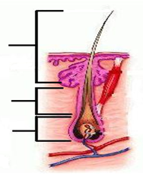
3 Divisions of Hair | Write These Definitions Under the Picture
 | Shaft: Protrudes above skin Root: Extends up from hair bulb Bulb: White/round portion of root
Hair Shaft
Hair Root
Hair Bulb

Slide 4
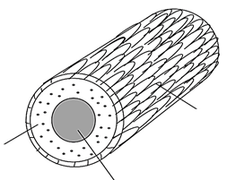
Hair Shaft Cross Section | Write These Definitions Under the Picture
 | Medulla: Middle (Central Core) Cortex: Thick layer that surrounds the medulla Cuticle: Outermost layer, covers cortex
Cuticle
Cortex
Medulla

Slide 5
Goosebumps:
Arrector pili muscle attaches to the hair follicle & pulls it upright (traps heat)

Slide 6
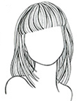
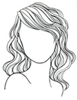
3 Hair Types
Round Shaft | Oval Shaft | Flat Shaft
Straight Hair | Wavy Hair | Curly/Kinky Hair

Slide 7
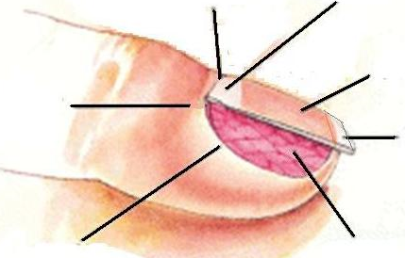
Nails:
Cuticle:
Dead skin at nail base.
Lunula:
“White Moon”
Nail Plate:
Outer exposed surface of nail.
Nail Matrix:
Where growth occurs
Free Edge:
Extends beyond finger tip.
Nail Bed:
Provides nourishment
Nail Fold:
Keeps foreign objects out

