Slide 1
Types of Joints
Anatomy 4.5

Slide 2
Definition:
Where two bones meet
A.K.A. “Articulation”

Slide 3
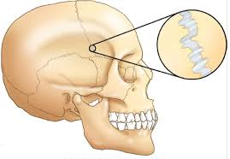
3 Types of Joints:
Fibrous
No movement at joint
Classified as
Synarthrosis
Example
Sutures in the skull

Slide 4
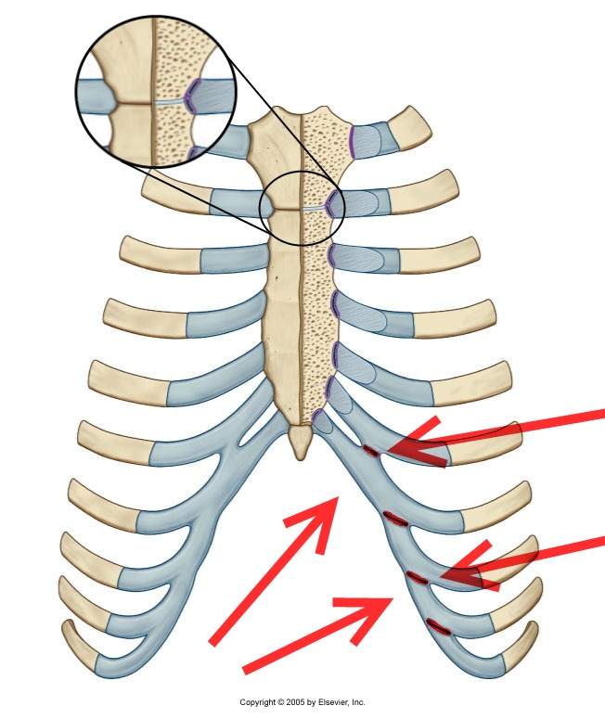
3 Types of Joints:
Cartilaginous
Slight movement at joint
Classified as
Amphiarthrosis
Example
Sternum & ribs attach

Slide 5
3 Types of Joints:
Synovial
Have burase sac (fluid) & allows great range of motion
Classified as
Diarthrosis
Example
6 Types Below

Slide 6
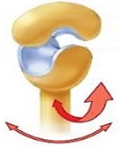
Saddle Joint:
Concave & convex
Example:
Metacarpal of thumb & carpal bone (wrist)

Slide 7
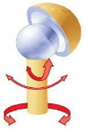
Ball & Socket Joint:
Head fits into groove
Example:
Humerus & scapula (shoulder)
Femur & hip

Slide 8
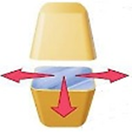
Gliding Joint:
Small bones glide past each other for quick movement
Example:
Wrist bones

Slide 9
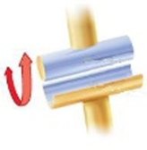
Hinge Joint:
Allows for bending & straightening
Example:
Humerus & Ulna
(elbow)

Slide 10
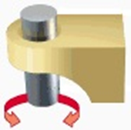
Pivot Joint:
Allows for rotation around an axis
Example:
Head of radius against the ulna

Slide 11
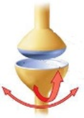
Condyloid Joint:
Allows movement but no rotation
Example:
Knuckles

