Slide 1
Burns
Anatomy 3.5

Slide 2
Rule of Nines
Divide body into 11 regions at 9% each (+1% groin) = 100% Burn Assessment

Slide 3
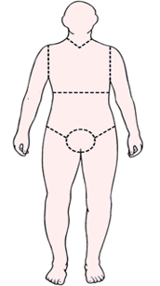
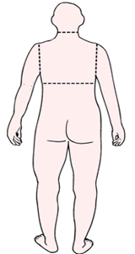
Anterior |  | Posterior
 | Head: 9% Chest: 9% Upper Back: 9% Abdomen: 9% Lower Back: 9% L. Arm: 9% R. Arm: 9% Front L. Leg: 9% Back L. Leg: 9% Front R. Leg: 9% Back R. Leg: 9% Groin: 1%
9
9
9
9
9
9
9
1
9
9
9
9

Slide 4
First Degree Burns:
Damage only to epidermis
Red, swollen
Example: Sunburn

Slide 5
Second Degree Burns:
Damage to epidermis & upper dermis
Red with blisters
Usually no permanent damage

Slide 6
Third Degree Burns:
Entire thickness of skin is destroyed
Blanched (white/gray)
Not painful due to nerves destroyed
Regeneration not possible

Slide 7
Why So Dangerous? | Treatment:
Victims lose a lot of water Infection (bacteria/fungi) | Skin Grafting

